Slide 1


- THE DATAMATICS Team Members: Aishwarya | Safiya | Diva | Kithuru Fathima
Guided Project
Detecting Building Defects Using VGG16 & IBM Watson

Slide 2
introduction
CORE
Detection of building defects including cracks and flakes on the wall surfaces is a crucial task of buildings’ maintenance, which if left undetected and untreated, can significantly affect the structural integrity and the aesthetic aspect of buildings.
Clients are increasingly looking for fast and effective means to quickly and frequently survey and communicate the condition of their buildings so that essential repairs and maintenance work can be done before it becomes too dangerous and expensive. As an alternative to manual on-site inspection methods, image analysis algorithms for detecting defects have been proposed.

Slide 3
The objective of the project is to build an application to detect the type of building defect model using an integrated webcam to capture the video frame and the video frame is compared with the pre-trained model and the type of building defect is identified and showcased on the OpenCV window.
OBJECTIVE

Slide 4
THEORY
MODEL BUILDING AND IMPLEMENTATION IN LOCAL SYSTEM
INTEGRATION WITH FLASK
MODEL BUILDING IN IBM WATSON STUDIO
TOPICS

Slide 5
THEORY

Slide 6
THEORY
Convolutional Neural Networks (ConvNet)
Subset of machine learning and are the heart of deep learning algorithms.
Used in classification and computer vision tasks.
Comprised of node layers, which contains an input layer, one or more hidden layers, and an output layer.
The convolution layer is where majority of computation occurs here and it requires the input data, a filter and a feature map.
The pooling layer reduces the number of parameters in the input.
Fully Connected layers allow each node in the output layer to connect directly to a node in the previous layer.

Slide 7
THEORY
VGG-16
The VGG-16 is a powerful network with simple architecture.
It is easier to modify for transfer learning and for the CAM technique without compromising the accuracy.
It has fewer layers (shallower) than other models.
The architecture of the VGG-16 model comprises five blocks of convolutional layers with max-pooling for feature extraction.

Slide 8
THEORY
Tools Used:
NumPy, Scikit-learn, VGG-16, OpenCV, Flask
Dataset
The training data and test data are separated into 3 classes: (crack,flake,roof) .
Training and Test data:
The training data is randomly chosen (70%) instances for each class, the total number of training data images is 816.
The test data is the remaining (30%) instances for each class, the total number of test data images is 318.

Slide 9
MODEL BUILDING AND IMPLEMENTATION IN LOCAL SYSTEM

Slide 10
MODEL BUILDING AND IMPLEMENTATION IN LOCAL SYSTEM
1. Image Pre-processing
1.1. Import the required libraries
from keras.preprocessing.image import ImageDataGenerator
ImageDataGenerator library is used to implement image data augmentation technique. It expands the training dataset to improve the performance and ability of the model and generalizes it.
An instance of the ImageDataGenerator class is constructed for train and test and apply ImageDataGenerator functionality to Trainset and Testset.
2. Model Building
For our model, we applied a fine-tuning transfer learning to a VGG-16 network. It is a pre trained CNN model on a huge dataset (ImageNet) with a lot of diverse image categories.

Slide 11
MODEL BUILDING AND IMPLEMENTATION IN LOCAL SYSTEM
2.1. Import the required libraries
from tensorflow.keras.layers import Input, Lambda, Dense, Flatten
from tensorflow.keras.models import Model
from tensorflow.keras.applications.vgg16 import VGG16
from tensorflow.keras.applications.vgg16 import preprocess_input
from tensorflow.keras.preprocessing import image
from tensorflow.keras.preprocessing.image import ImageDataGenerator, load_img
from tensorflow.keras.models import Sequential
import numpy as np
from glob import glob

Slide 12
MODEL BUILDING AND IMPLEMENTATION IN LOCAL SYSTEM
2.2. Data cleaning
The images are resized to standardize the size of the images in the dataset.
2.3. Creation of the CNN Model
The pre-trained CNN Model is used as a feature extractor.
Dense layer is added. An object of the model is created, and input is given as VGG16.input and output as dense layer. Activation function used is softmax.
2.3.1. Compiling the model
It is the final step in creating a model. We have used loss function in Keras during the model compilation process. The adam optimizer is used to optimize the input weights by comparing the prediction and the loss function. Metrics used is accuracy.

Slide 13
MODEL BUILDING AND IMPLEMENTATION IN LOCAL SYSTEM
2.4. Train the model
We trained the model with our image dataset. The model is trained for 10 epochs and after every epoch, the current model state is saved if the model has the least loss encountered till that time.
2.5. Save the model
The generated model is saved as a file with .h5 extension.
2.6. Test the model
We tested the model to check if it’s the best fit for the given problem and corresponding data.
Load the saved model using load model. Take an image as input and check the results. Using the model, we predicted the output for the given input image.

Slide 14
INTEGRATION WITH FLASK

Slide 15
INTEGRATION WITH FLASK
Required libraries related to open cv and VGG16 have been imported in the python code. Our flask application has two routes: ‘/’ (leads to home.html) and ‘/end’ (leads to end.html). We have used CSS for styling the page. The webcam opens when the ‘Open Webcam’ button is clicked. Objects are shown through the webcam and our CNN model predicts the type of defect and displays it on the flask webpage.

Slide 16
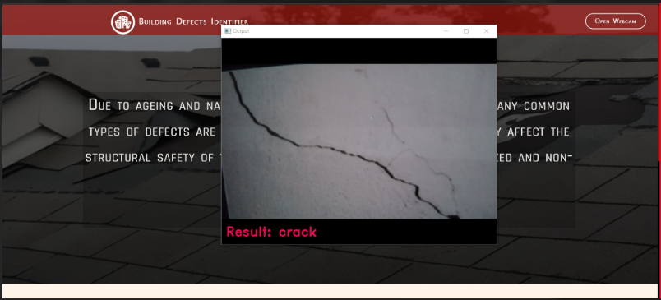
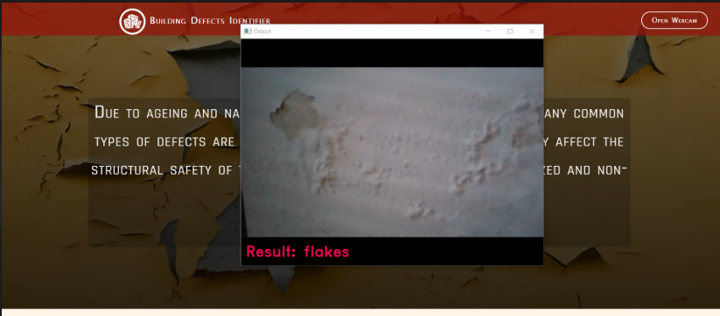
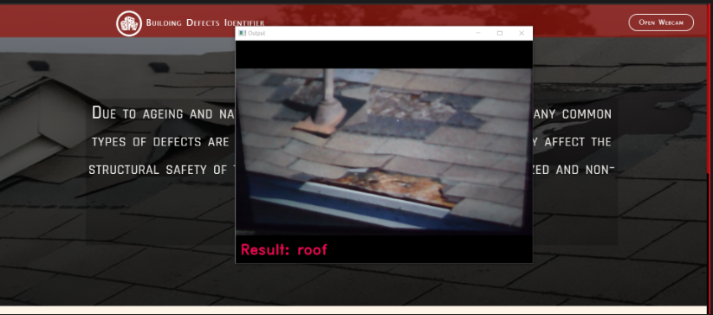
INTEGRATION WITH FLASK
OUTPUT

Slide 17
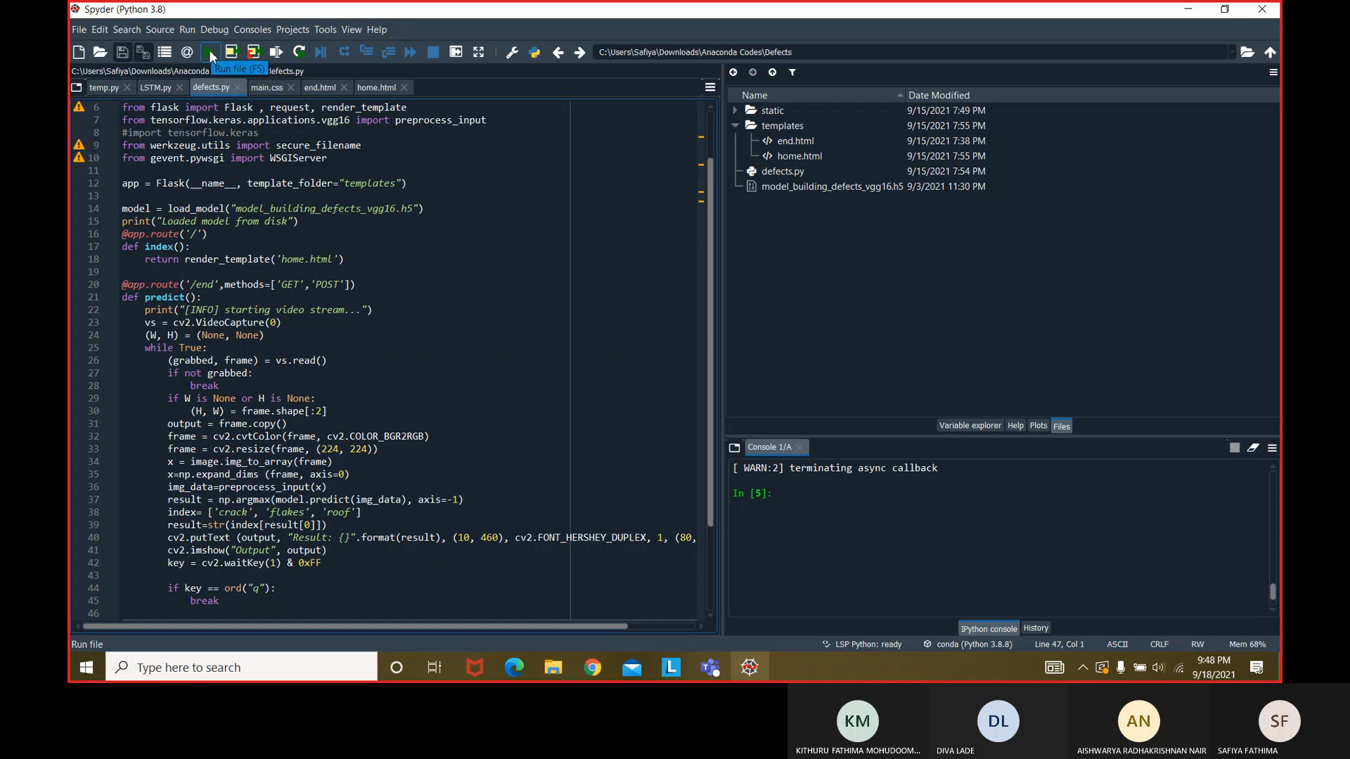
VIDEO DEMONSTRATION OF PROJECT

Slide 18
MODEL BUILDING IN IBM WATSON STUDIO

Slide 19
MODEL BUILDING IN IBM WATSON STUDIO
Libraries used:-
1) keras:for developing and evaluating deep learning models.
class imported: ImageDataGenerator
2) tensforflow: for fast numerical computing created.
class imported:Input, Lambda, Dense, Flatten, Model, VGG16, preprocess_input, image, load_img, Sequential
3) BytesIO: methods that manipulate bytes data in memory.
class imported: io, zipfile
4) glob: used to return all file paths that match a specific pattern.

Slide 20
MODEL BUILDING IN IBM WATSON STUDIO
5) numpy: to perform a wide variety of mathematical operations on arrays.
6) pandas:is a fast, powerful, flexible and easy to use open source data analysis and manipulation tool.
7) os:provides functions for interacting with the operating system.
8) types: contains type objects for all object types defined by the standard interpreter.
9) botocore.client:low-level interface to a growing number of Amazon Web Services.
class imported: Config
10) ibm_boto3:the IBM COS SDK for Python, which allows Python developers to write software that makes use of IBM's COS service.

Slide 21
Thank you

